Slide 1
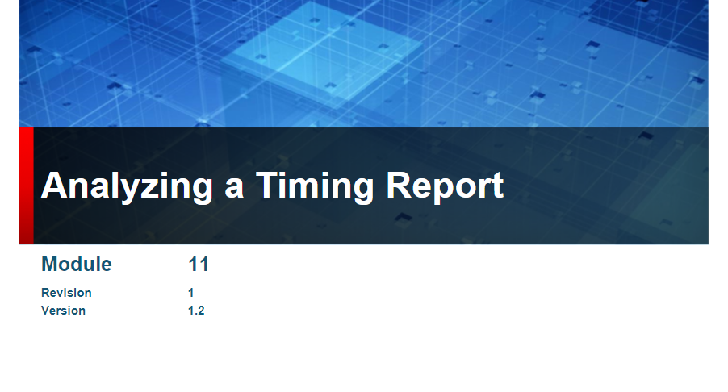

Slide 2
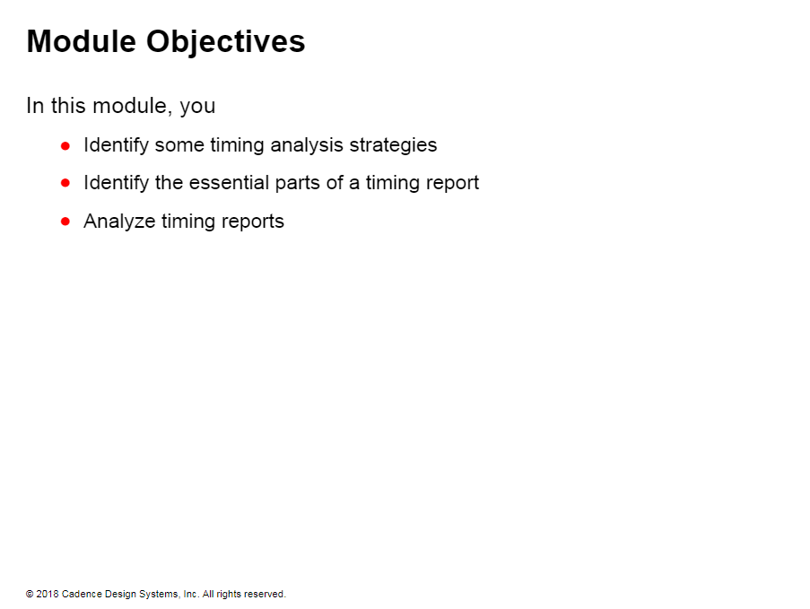

Slide 3
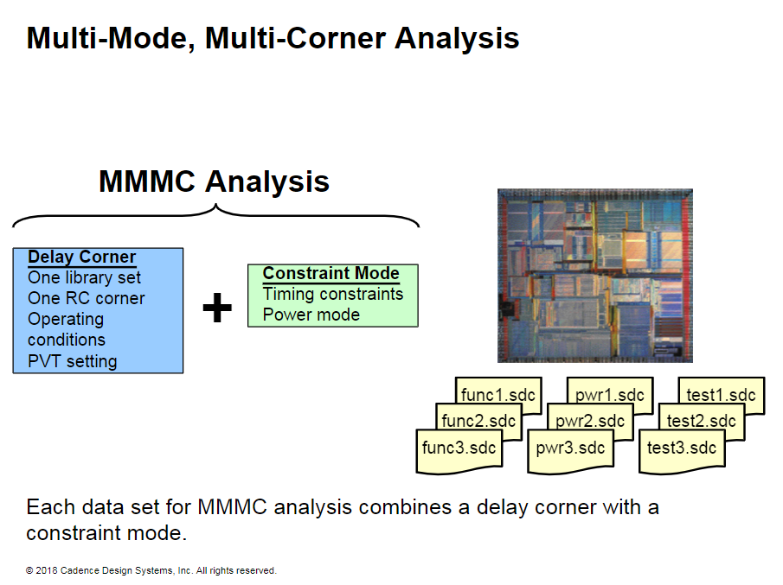
Notes:
Multi-Mode, Multi-Corner Analysis
Today’s chips include:
Multiple standards support
Multiple functionalities
Multiple power profiles
Multiple test modes
These conditions result in multiple constraint sets.
MMMC analysis needs to understand the conditions under which to run and the design mode to execute in.
In the slide, the conditions are named “Delay Corner” and the design mode is named “Constraint Mode”.
The multiple MMMC analyses use combinations of Delay Corners and Constraint Modes to comprehensively evaluate the performance of the design.

Slide 4
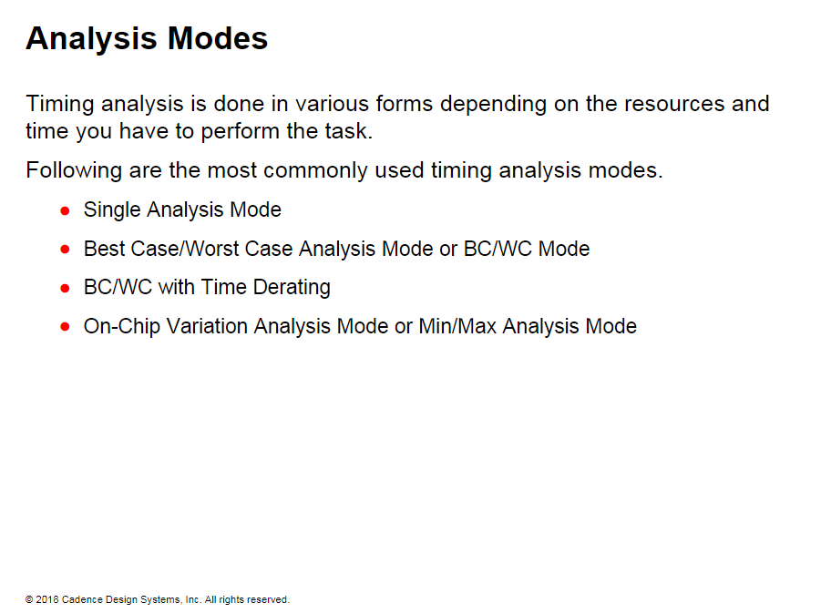

Slide 5
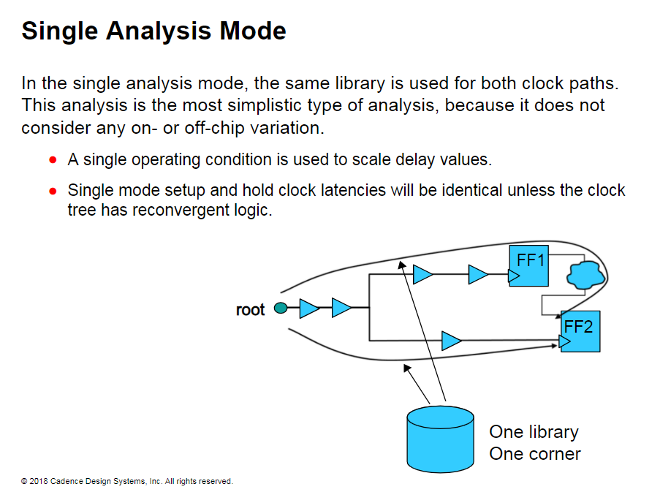
Notes:
Single Analysis Mode
Single setup mode:
Launch clock + data path: Late path (Or longest path) <= Capture clock path: Early path (Or shortest path) + Clock Period - Setup
Single hold mode:
Launch clock + data path: Early path (Or shortest path) >= Capture clock path: Late path (Or longest path) + Hold
By default, Synopsys® PrimeTime® performs early/late analysis with a single library. You can nin Cadence® Encounter® Timing System in on-chip variation (OCV) mode to get similar early/late analysis with a single library.

Slide 6
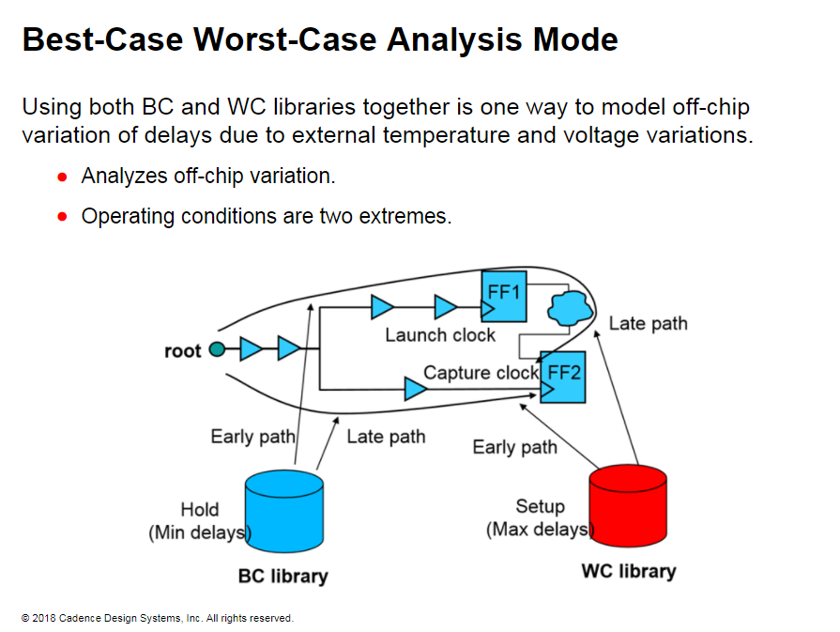
Notes:
Best-Case Worst-Case Analysis Mode
BC/WC Setup Mode:
Launch Clock + Data path: Max delays + Late path Capture clock path: Max delays + Early path
BC/WC Hold Mode:
Launch Clock + Data path: Min delays + Early path Capture clock path: Min delays + Late path

Slide 7
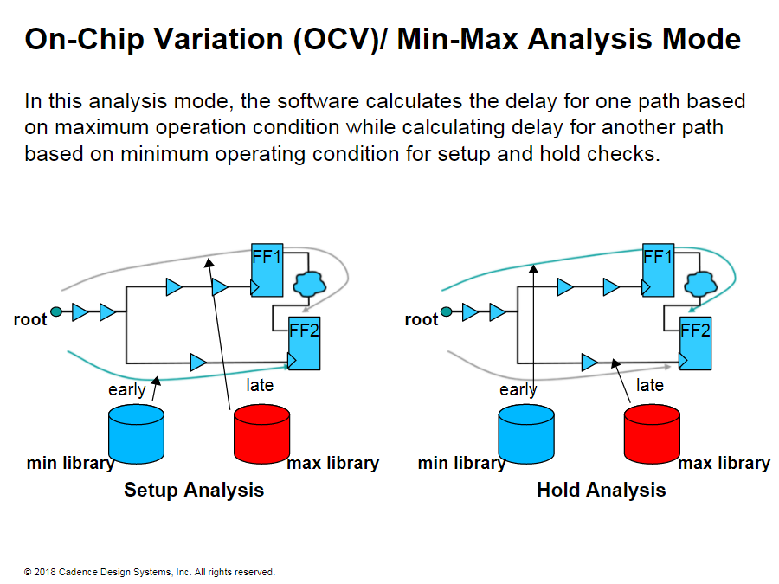
Notes:
On-Chip Variation (OCV)/ Min-Max Analysis Mode
In this mode, the software analyzes variations across a chip during operation. This method is also known as min-max analysis.
On-chip variation (OCV) for pessimistic setup checks would speed up the clock to FF2 and slow it down for FF1.
This could effectively make the data from FF 1 late to FF2 D-input causing a setup time violation. Using the mixed libraries models a worst case OCV situation.
On-chip variation for hold checks does the opposite of the setup checks.
The data from FF 1 arrives sooner due to the fast or min library being applied to that clock path.
The slow or max delay library is applied to the clock path to FF2. This shifts the clock edge closer to the data edge possibly revealing a hold time violation. The data edge is shifted towards the FF2 clock edge and the FF2 clock edge towards the data edge.
OCV Setup Mode
Launch Clock + Data path: Max Delays + Late path Capture clock path: Min Delays + Early path
OCV Hold Mode
Launch Clock + Data path: Min Delays + Early Path Capture clock path: Max Delays + Late Pathnch Clock + Data path: Min Delays + Early Path Capture clock path: Max Delays + Late Path

Slide 8
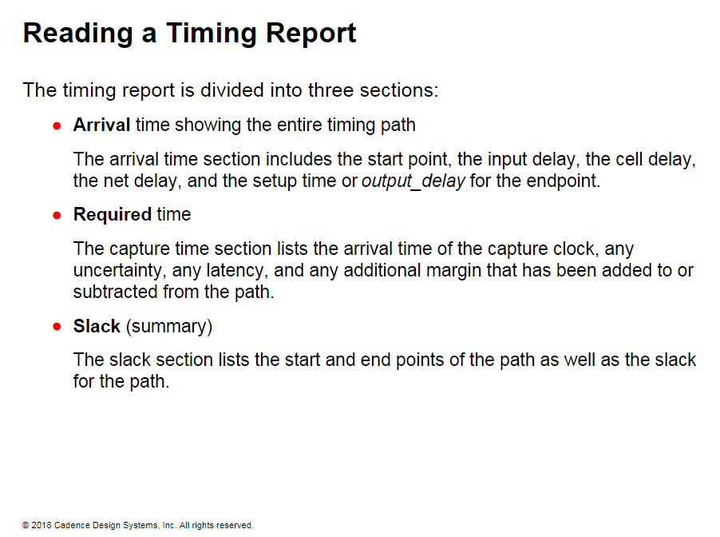

Slide 9
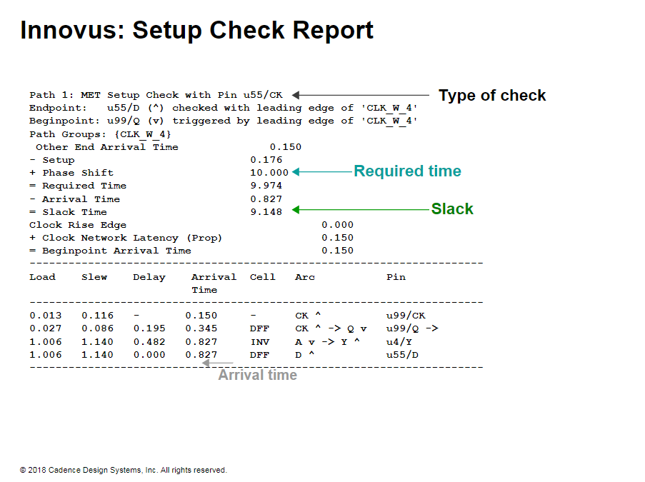
Notes:
Innovus: Setup Check Report
The example report shows a setup timing check created in the Innovus® Implementation System. The calculation of required time includes setup. The report also shows the calculation of the arrival time along the timing path.

Slide 10
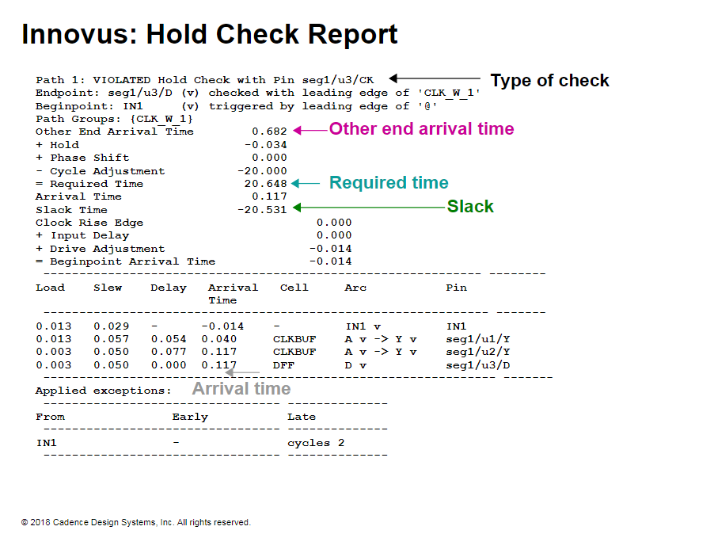
Notes:
Innovus: Hold Check Report
This report shows a hold check in the Innovus® Implementation System.
The report also includes the other end arrival time calculated as the time that the clock signal arrives at the capture clock.
The hold is shown in the required time section and is added to the required time. The other end arrival time is mainly helpful when the capture clock is different from the launch clock.

Slide 11
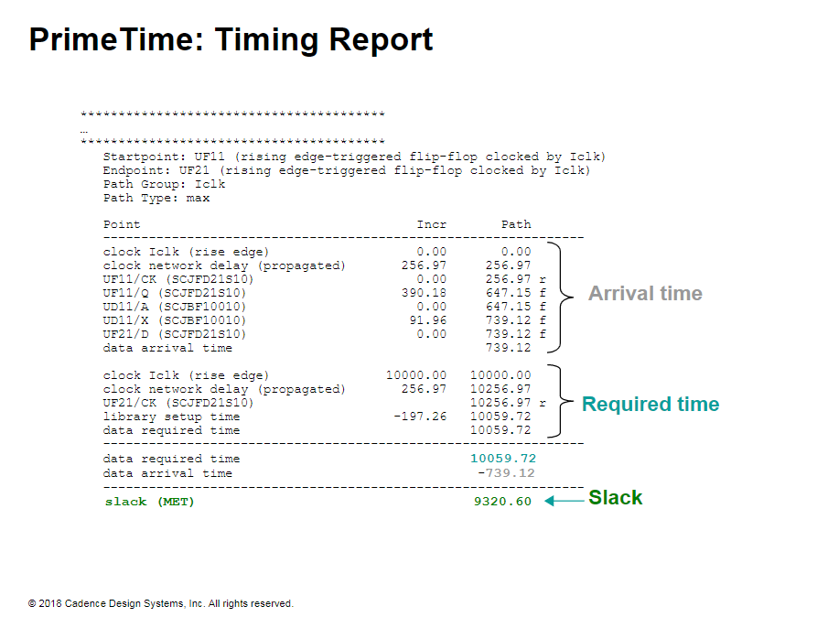
Notes:
PrimeTime: Timing Report
The shown report is a PrimeTime report. The report shows the arrival time. the required time and the slack calculations in separate sections.
The report type and the start and end points are given at the beginning of the report.

Slide 12
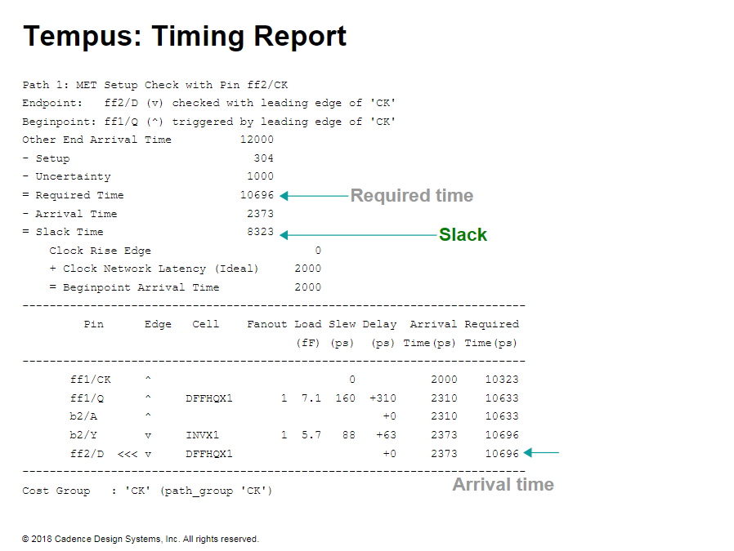
Notes:
Tempus: Timing Report
In this example report, notice the following:
The start point and the end points
The timing path is shown from the start point to the end point.
The slack. the required. and arrival times
The clock uncertainty
The instance arcs
The delay through the cell for each arc.

Slide 13
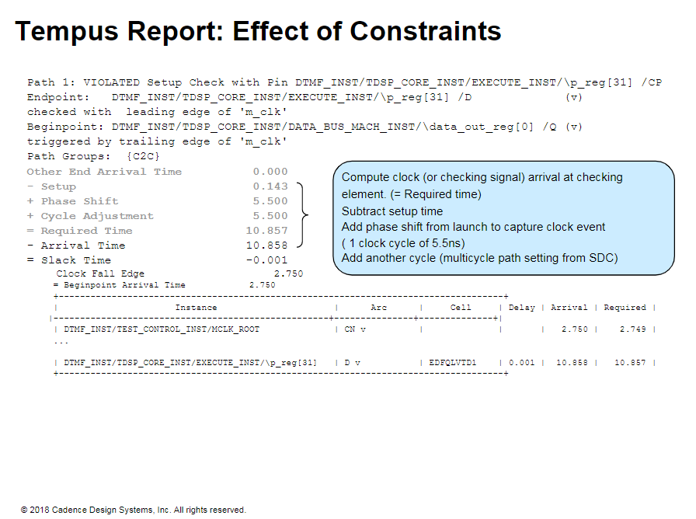
Notes:
Tempus Report: Effect of Constraints
The values in the SDC affect the delays on your report. You must always check for a corresponding constraint in your SDC file, and whether it was intended.
Constraints that are similar to the following must be present in your SDC file for the above report.
create_clock -name "m clk" -add - period 5.5 -wave {0.0 2.75} [get_pins DTIMF_INST/TEST_CONT ROL_INST/m_clk]
set_multicycle path -to [list [get_cells {DTMF_INST/TDSP_CORE_INST/EXECUTE_INST/p_reg*}] -setup -end 2
The report shows a multicycle path of one cycle. You have a corresponding cycle of one additional cycle for the setup check. Thus. the constraints match with the report.

Slide 14
